Slide 1



Introduction to Ivy and I4
Xiaosong Gu
2022年04月15日

Slide 2
Ivy: Safety Verification by Interactive Generalization
What is Ivy
Overview: Interactive Verification with Ivy
Methodology for Safety Verification
Experiment & Discussion

Slide 3
What is Ivy

Slide 4
What is Ivy
Automated verification methods fail in ways that are opaque to users
Failing to produce inductive invariants
Failing to prove that an invariant is inductive
Ivy: making failures visible
User-guided interactive invariants generalization with automated procedures
Symbolic bounded verification
Interactive search for inductive invariants
Counterexamples visualization
Restricted specification language and invariants for decidability
Relational Modeling Language
Notes:
使得这些方法难以在实际中应用
这些方法在失败的时候 不会告诉用户为什么失败
若不是归纳不变式 用户不知道为什么失败，应该如何修改 增强还是减弱
Prover无法证明 在这种情况下，用户也不知道该怎么做
保证所有的验证可以由求解器自动验证
使用数学关系 来 表示程序的状态

Slide 5
Overview: Interactive Verification with Ivy

Slide 6
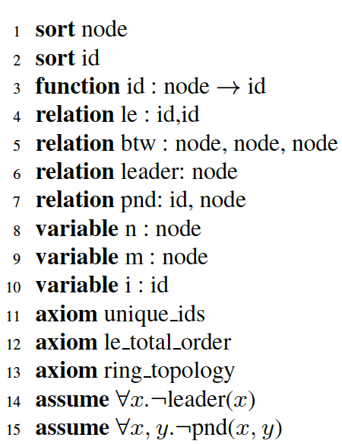
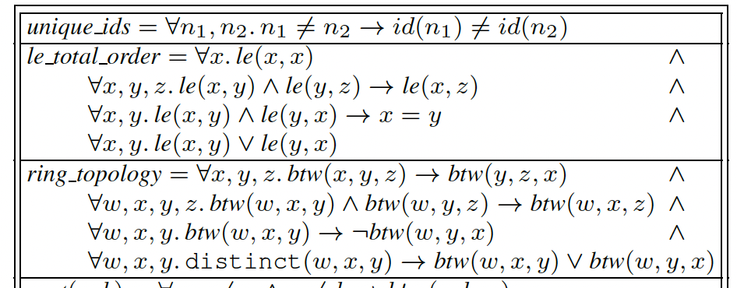
Example: Leader Election in a Ring
Finite sets, no specific assignment is needed
Relations represent program states
“local variables”
Properties that all states satisfy
Initial state
Notes:
这个例子论文中的例子 跟ivy教程中的有些不一样 教程中进行了优化，更符合程序习惯
不需要限制节点的个数 因此可以验证无穷的情况
类似于局部变量 就像tla+中的\e s
所有的状态能满足的性质

Slide 7
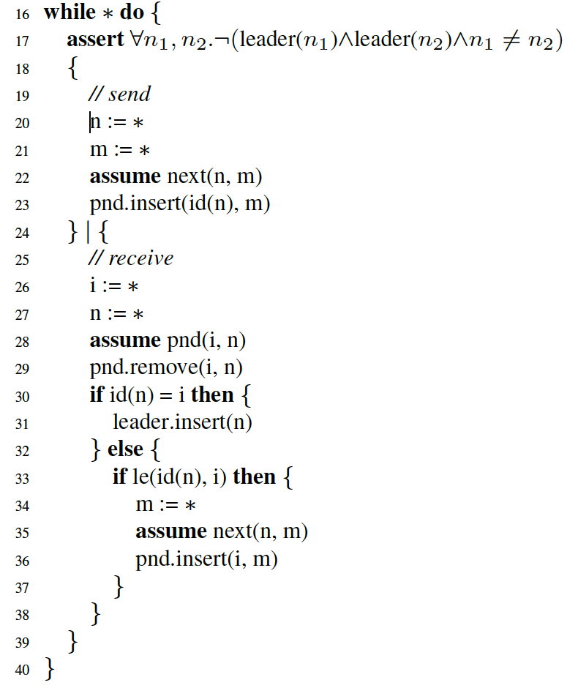
Example: Leader Election in a Ring
Safety property to verify
The core of the RML program is a non-deterministic loop
Send action
Each iteration performs one action
Conditional execution
Receive action
Notes:
这个例子论文中的例子 跟ivy教程中的有些不一样 教程中进行了优化，更符合程序习惯
类似于局部变量 就像tla+中的\e s
所有的状态能满足的性质

Slide 8
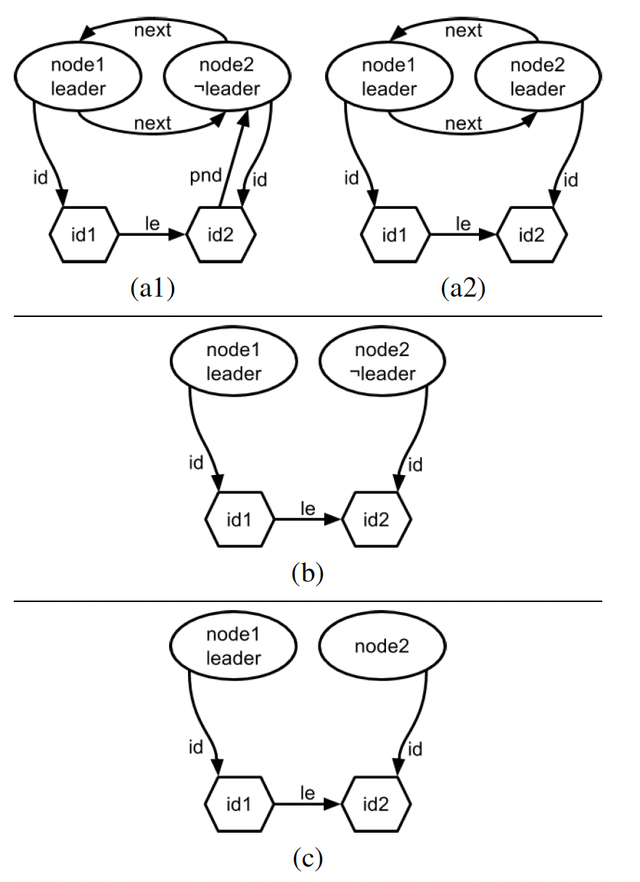
Graphical Visualization of State

Slide 9
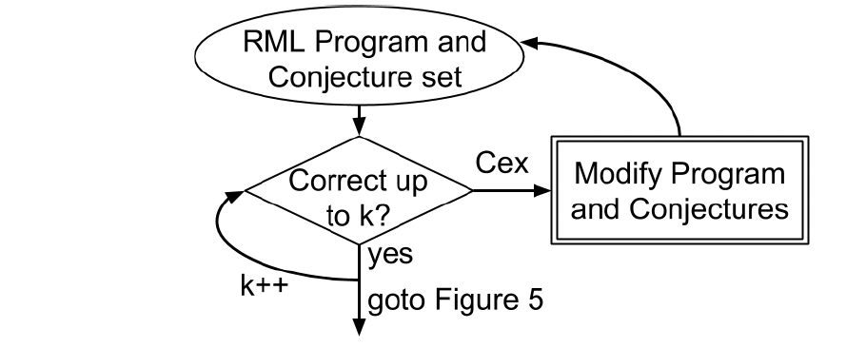
Bounded Verification
Ivy tests if any k transitions(loop iterations) can lead to an assertion violation
Effective for finding bugs in protocol or desired properties
An error trace is given if any violation is detected
Notes:
用于debug
只能验证程序在有限步内成立

Slide 10
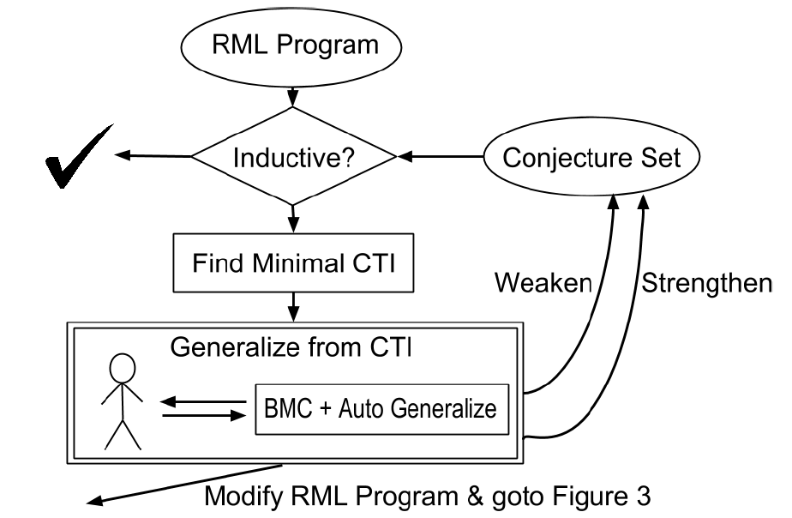
Interactive Search for Inductive Invariants
Inductive invariants
Initiation, consecution, safety
Given an invariant, Ivy automatically checks if it is inductive
Proving that the invariant is inductive
Showing a finite counterexample to induction(CTI) graphically
Notes:
验证程序正确
若找到一个反例，并不能说明safety被违背，只是这个不变量不是我们寻找的归纳不变量
，找到归纳不变量非常困难

Slide 11
Interactive Search for Inductive Invariants
Incrementally search for inductive invariants according to CTIs
Starts with a set of conjectures
When a CTI is found
Revise the RML program and start over bounded model checking
Weaken the candidate invariant by removing a conjecture
Strengthen the candidate invariant by adding a conjecture

Slide 12
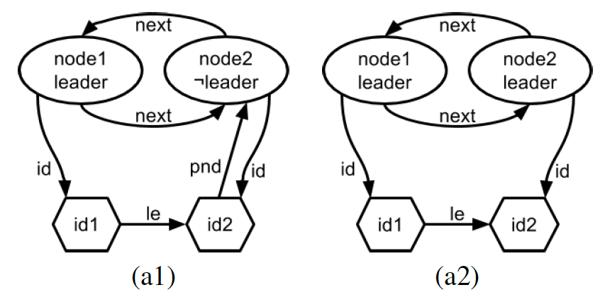
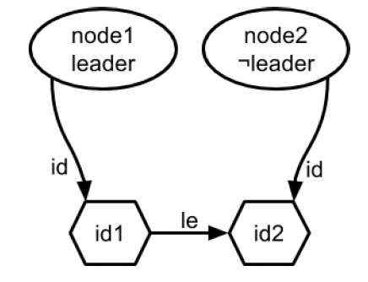
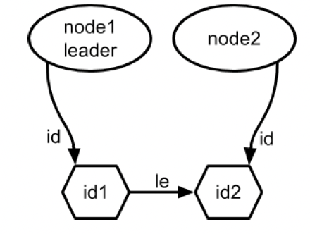
Graphical Visualization of Conjectures

Slide 13
Obtaining Helpful CTIs
Ivy searches for “minimal” CTIs that are easy to understand and indicative of the proof failure
Various minimization parameters

Slide 14
Interactive Generalization from CTIs
Counter example
User generalization
Ivy generalization
Identify irrelevant features from a specific counterexample
User guidance: user has to eliminate some features of the CTI that the user judges to be irrelevant
Ivy BMC: use BMC to checker whether user’s generalization is sound
If a CTI is found, a trace is displayed for user to diagnose the problem
If test succeeds, Ivy automatically suggests a stronger generalization
Notes:
这是ivy需要用户参与的地方 也是困难的地方

Slide 15
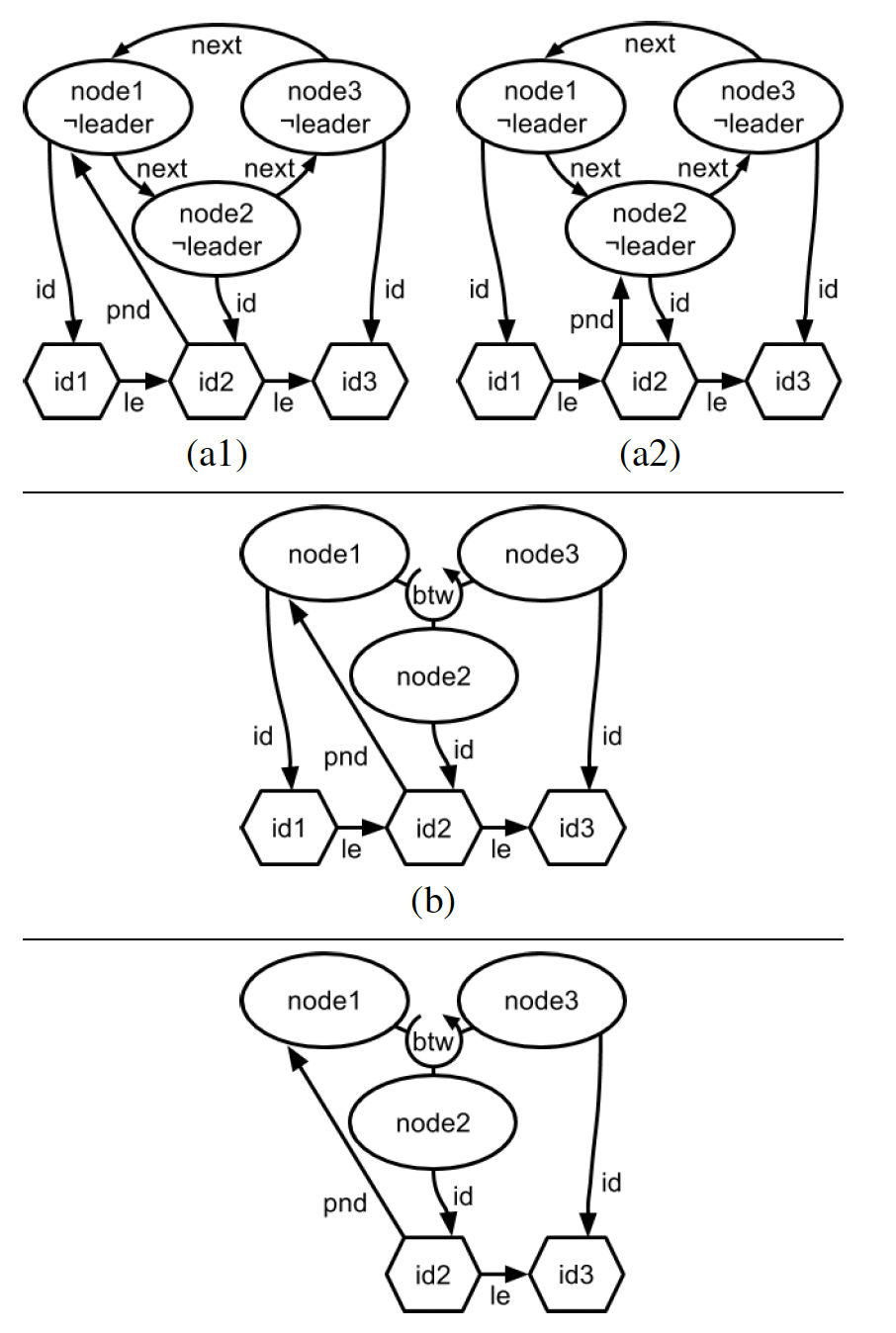
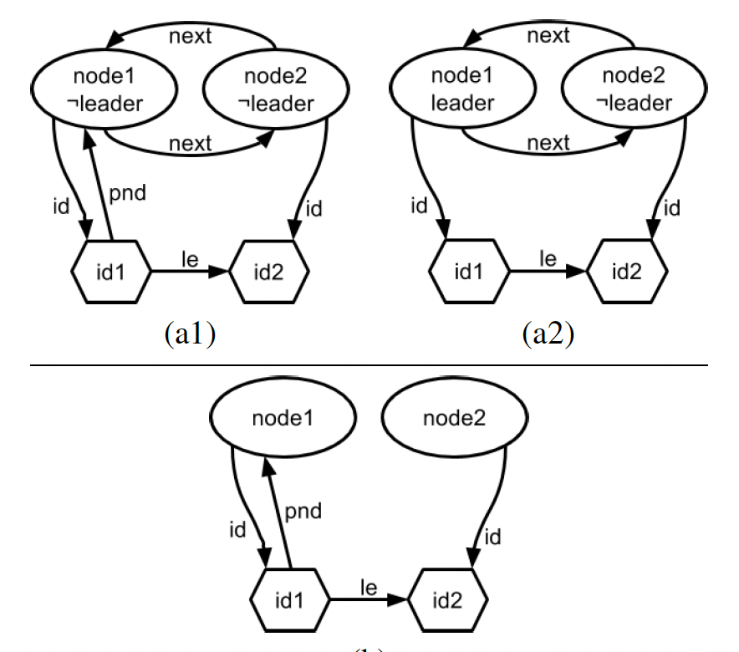
Interactive Generalization from CTIs

Slide 16
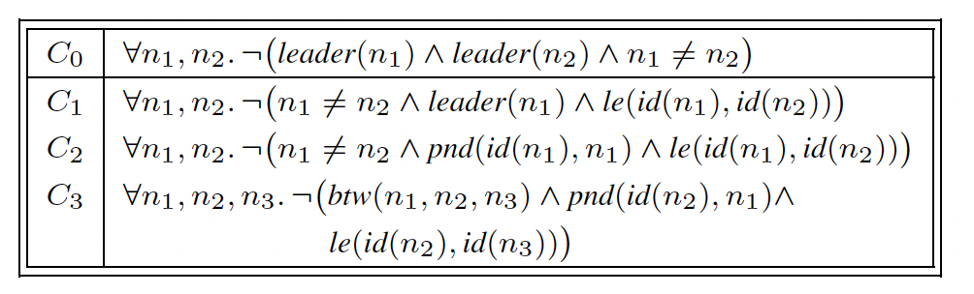
Interactive Generalization from CTIs
Inductive invariants for ring election

Slide 17
Methodology for Safety Verification

Slide 18
Relational Modeling Language
A Turing-complete language suitable for modeling infinite-state systems
Checking verification conditions for RML programs in decidable
Limits
Data structures: finite relations and stratified functions
Restricted structure for program conditions and update formulas
Only universally quantified invariants are supported

Slide 19
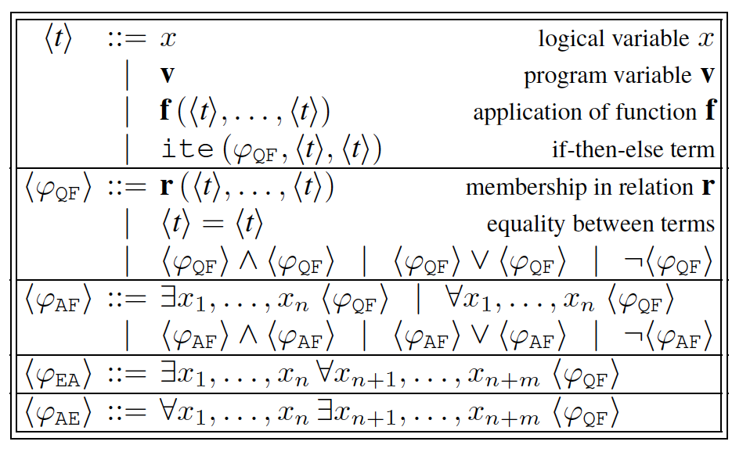
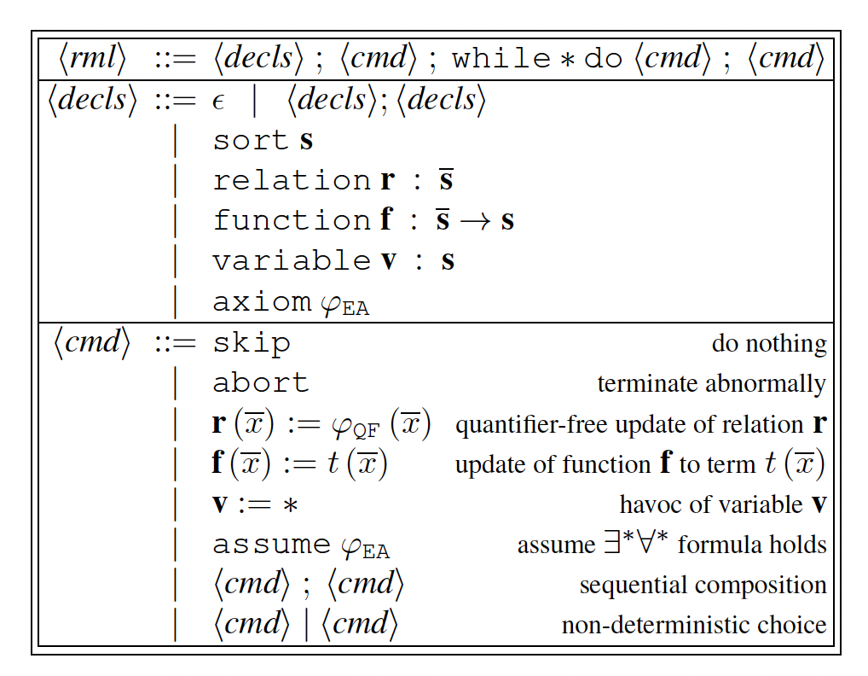
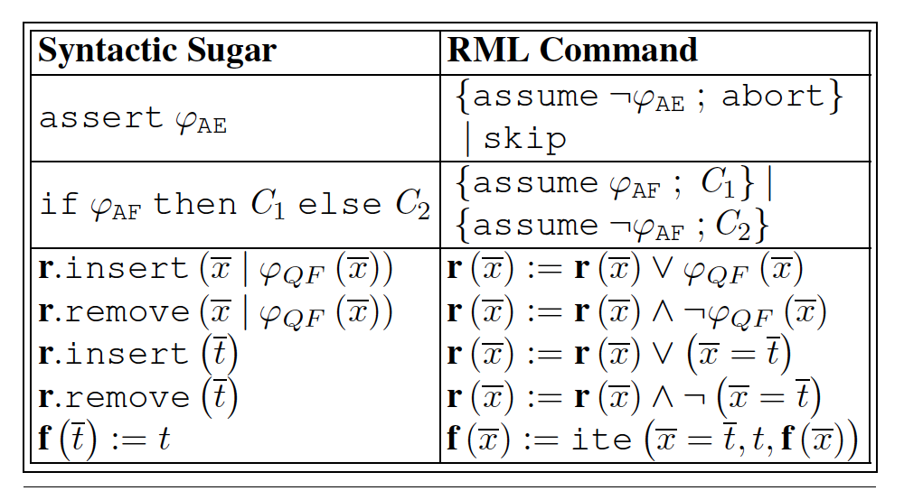
Syntax of RML

Slide 20
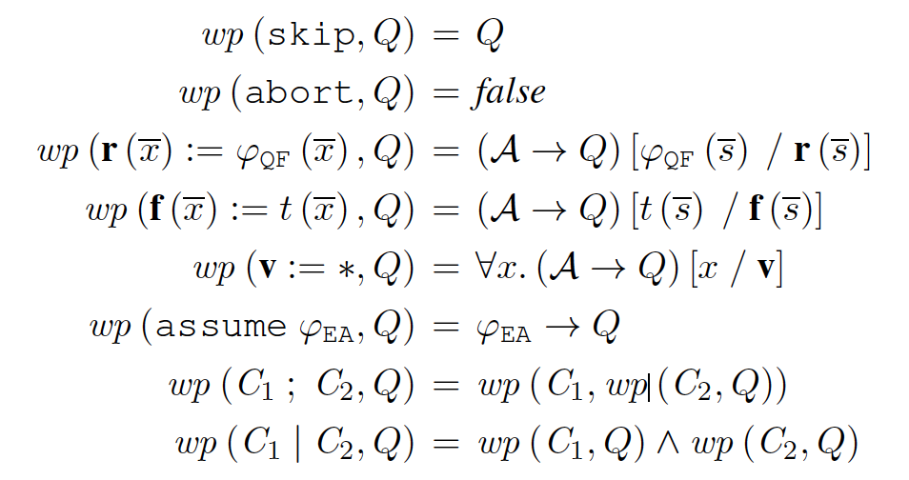
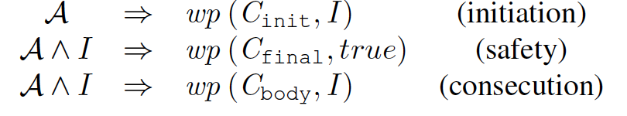
Axiomatic Semantics

Slide 21
Experiment & Discussion

Slide 22
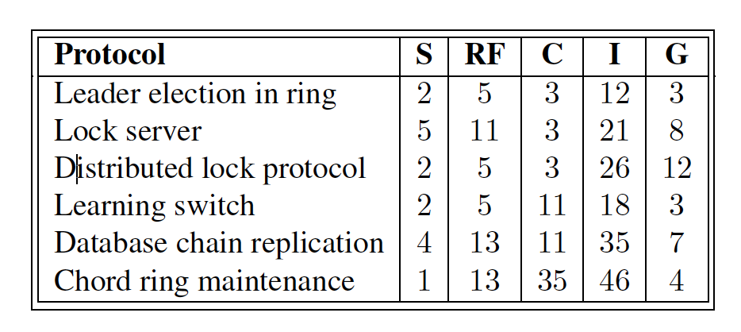
Experiment Results

Slide 23
Discussion
Modeling protocols in Ivy
Sometimes some approximation is needed
Bounded verification
Useful for debugging even for small number of steps
Finding inductive invariants
Visualization of CTIs and automatic generalization are useful
Comparing to Coq and Dafny
Ivy significantly reduces verification effort
Notes:
Tlc 对于这两种是相同的
Apalache不同，验证invariant不需要枚举

Slide 24
I4: Incremental Inference of Inductive Invariants of Distributed Protocols

Slide 25
Contents
What is I4
Overview of I4
Methodology
Evaluation

Slide 26
What is I4

Slide 27
What is I4
A bottleneck of existing formal verification technique: finding inductive invariants automatically
A key observation
The basic elements of invariants are independent of the size of the system
Invariants can be inferred from small, finite instances
I4
Identifying inductive invariant for a small instance
Infer a generalized invariant from instance-specific invariant
Notes:
比如paxos的quorum系统

Slide 28
Overview of I4

Slide 29
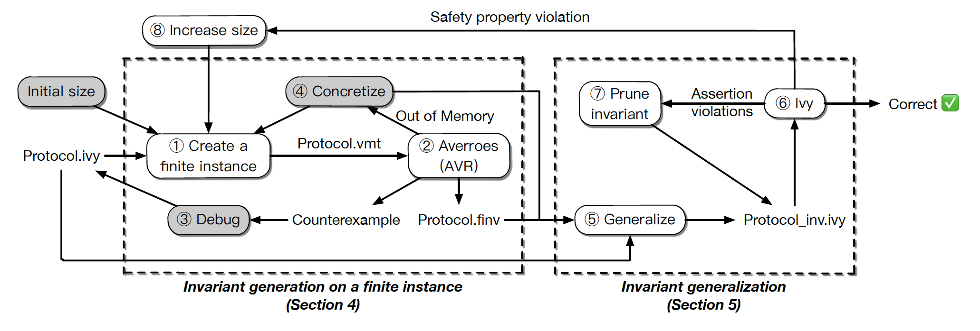
Overview of I4
Notes:
自动编码为vmt格式

Slide 30
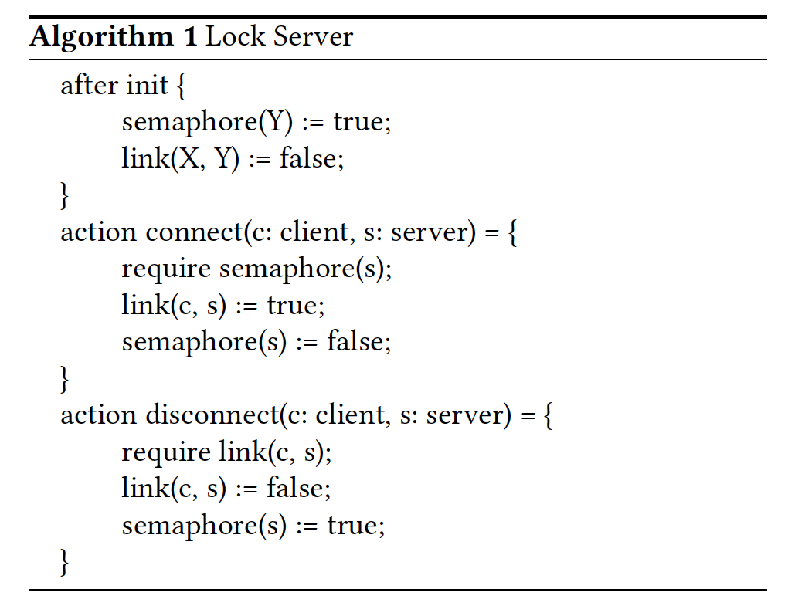
Invariant Generation on a Finite Instance
Input: protocol encoded in Ivy

Slide 31
Invariant Generation on a Finite Instance
Picking a size for the finite instance
E,g., number of clients, servers, requests, epochs
Large enough to exhibit patterns that can be generalized to full protocol
Small enough for automatic model checking
Translation from unbounded to finite domain
I4 translates the Ivy implementation to a finite VMT instance
Notes:
这样，所有的公式中没有量词，任意和存在可以被替换

Slide 32
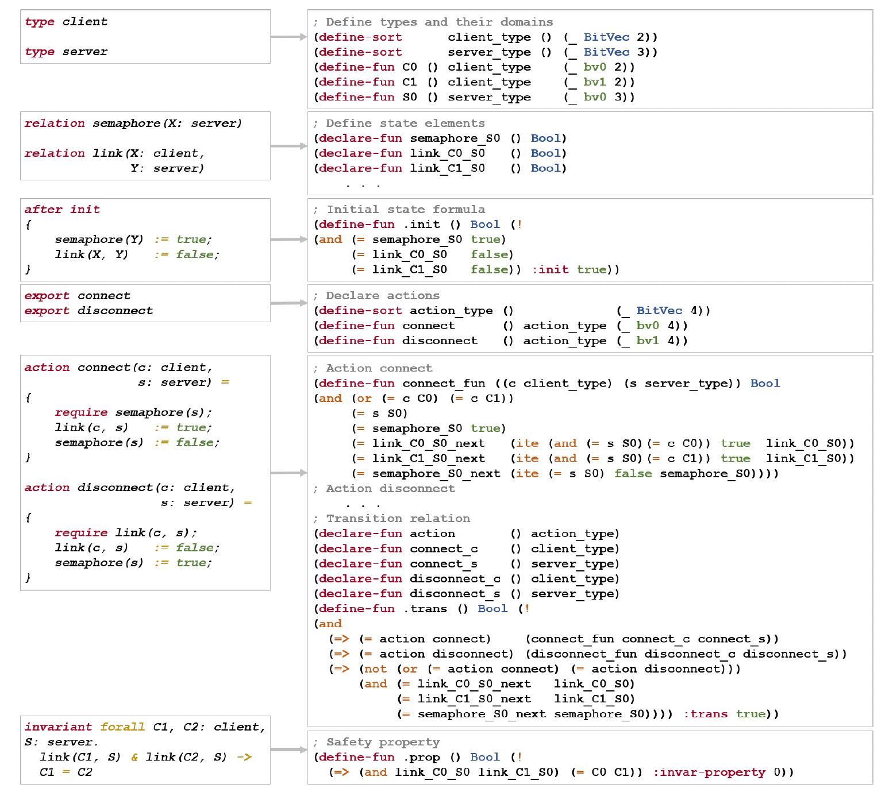
Invariant Generation on a Finite Instance

Slide 33
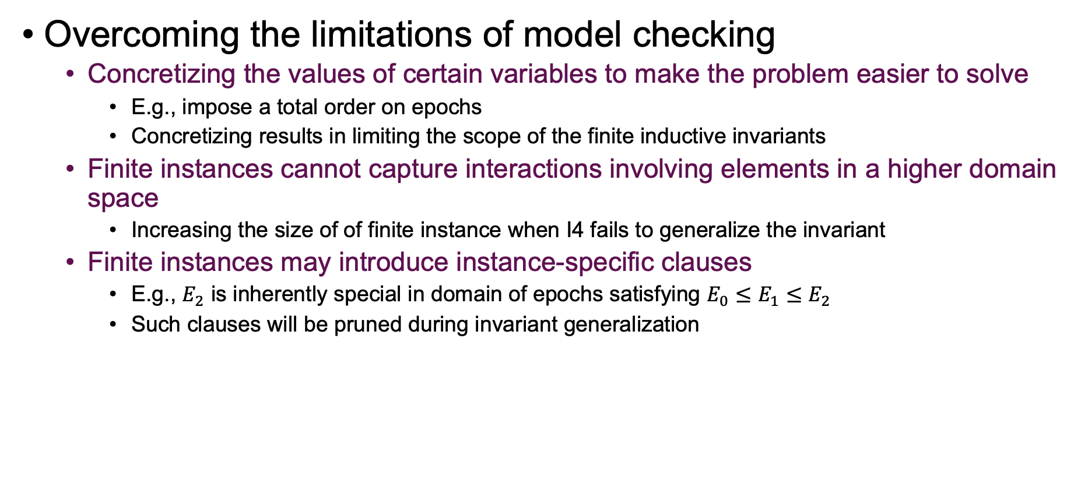
Invariant Generation on a Finite Instance
Overcoming the limitations of model checking
Concretizing the values of certain variables to make the problem easier to solve
E.g., impose a total order on epochs
Concretizing results in limiting the scope of the finite inductive invariants
Finite instances cannot capture interactions involving elements in a higher domain space
Increasing the size of of finite instance when I4 fails to generalize the invariant
Finite instances may introduce instance-specific clauses
E.g., $E_{2}$ is inherently special in domain of epochs satisfying $E_{0}≤E_{1}≤E_{2}$
Such clauses will be pruned during invariant generalization
Notes:
比如如果有限模型只包含两个节点 ，那么无法刻画包含3个节点的行为
对于一般的模型不使用

Slide 34
Invariant Generation on a Finite Instance
Invariant generation on the finite instance
Ivy passes the VMT instance to Averroes for model checking
An inductive invariant for the finite instance
A counterexample illustrating an error in the specification
Notes:
比如如果有限模型只包含两个节点 ，那么无法刻画包含3个节点的行为
对于一般的模型不使用

Slide 35
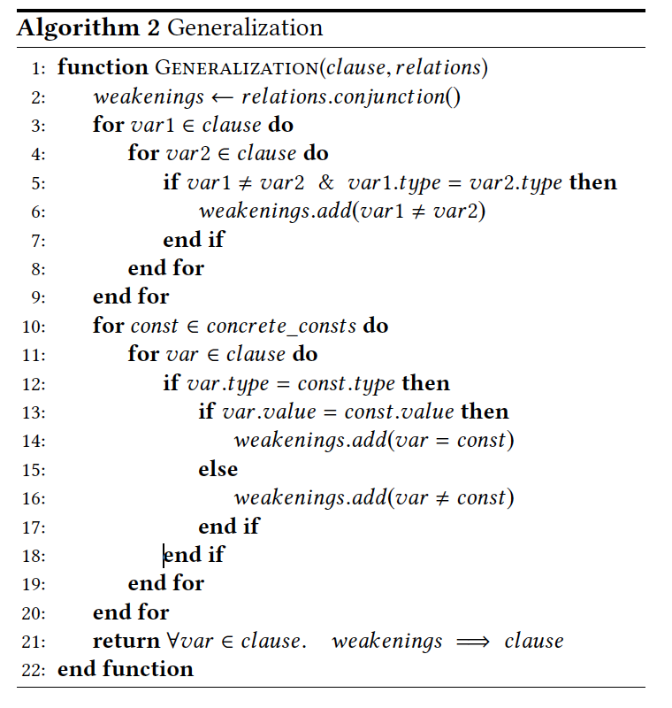
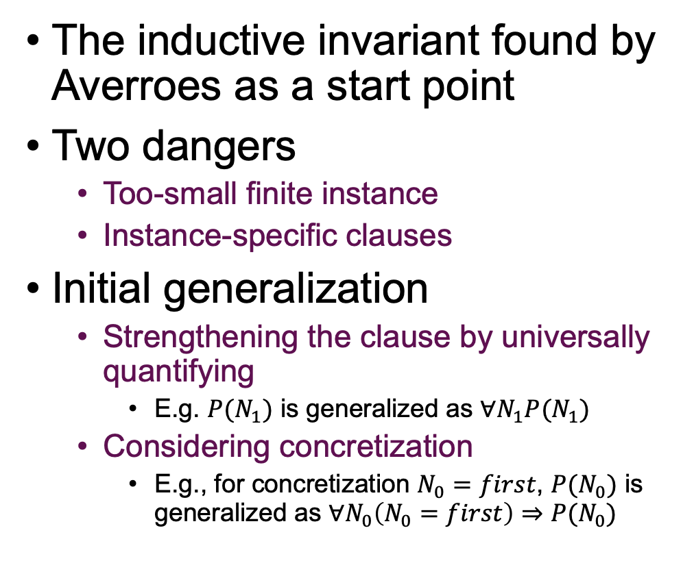
Invariant Generalization
The inductive invariant found by Averroes as a start point
Two dangers
Too-small finite instance
Instance-specific clauses
Initial generalization
Strengthening the clause by universally quantifying
E.g. $P(N_{1})$ is generalized as $∀N_{1}P(N_{1})$
Considering concretization
E.g., for concretization $N_{0}=first$, $P(N_{0})$ is generalized as $∀N_{0}\left(N_{0}=first\right)⇒P(N_{0})$
Notes:
互斥的锁 只有一个节点

Slide 36
Invariant Generalization
Invariant pruning
The generalized invariants are passed to Ivy to check whether that are inductive and sufficient to prove the correctness
Possible outcomes
Ivy proves the correctness using the invariants
The invariants are inductive, but fail to prove the correctness
Create an instance with a larger size and try again
Invariants are not inductive
Failure because the invariants are too strong
Remove instance-specific clauses and try Ivy again
Failure because the invariants are too weak
Pruning clauses one by one until the invariants are too weak to prove correctness, and try again with a larger instance
Notes:
互斥的锁 只有一个节点

Slide 37
Evaluation

Slide 38
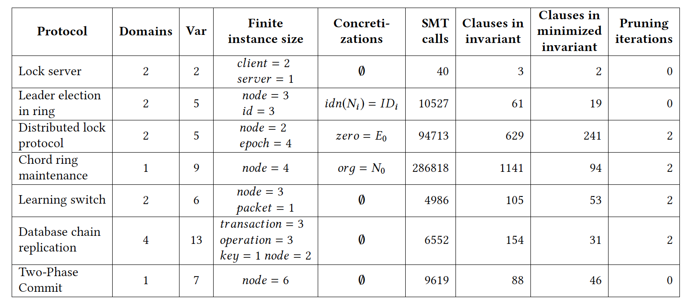
Evaluation
Various parameters for creating finite instances
Notes:
尝试了paxos 但是无法解决

Slide 39
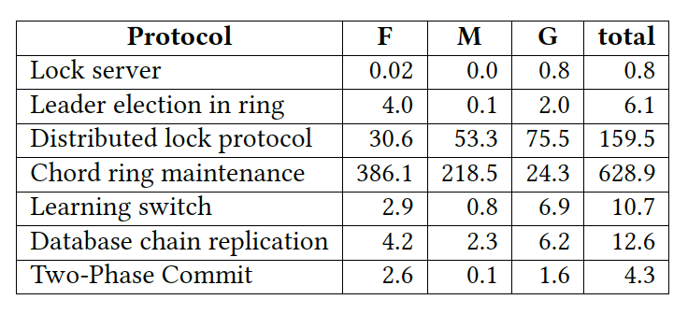
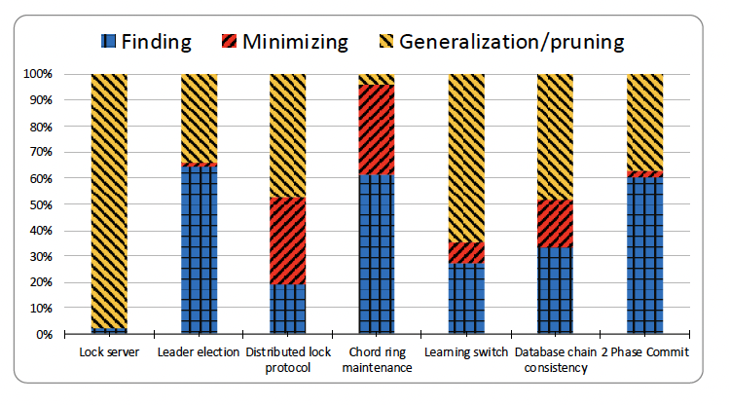
Evaluation
Runtime breakdown of I4’s verification
Notes:
互斥的锁 只有一个节点

Slide 40
Limitations and Future Directions
Choosing an instance size
Existential quantifiers
Verifying implementations
Optimizing model checking for distributed systems

Slide 41
Thank You

